Slide 1
Comparative Analysis of Stock Performance
(2018-2023)
By: Juliet

Slide 2
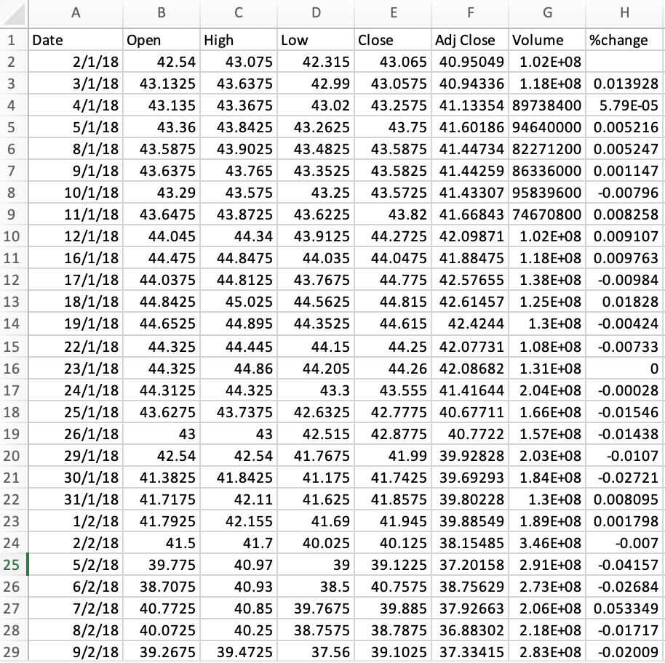
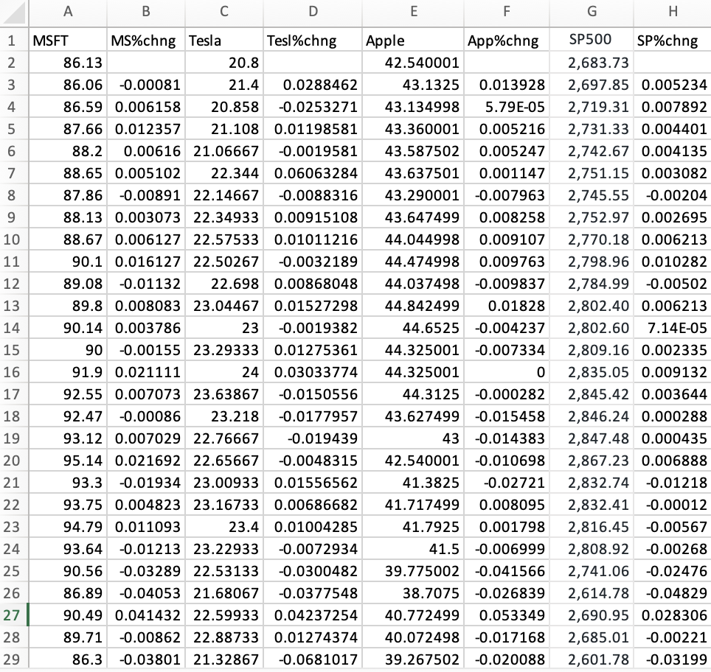
Dataset Description

Slide 3
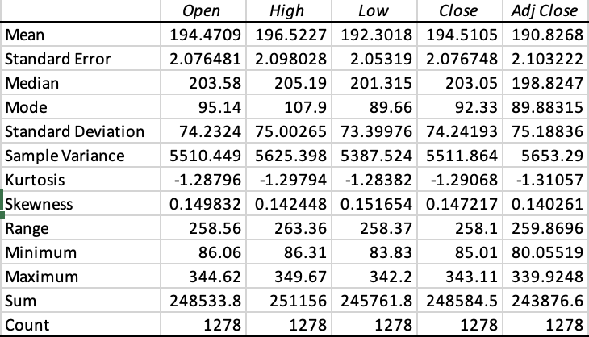
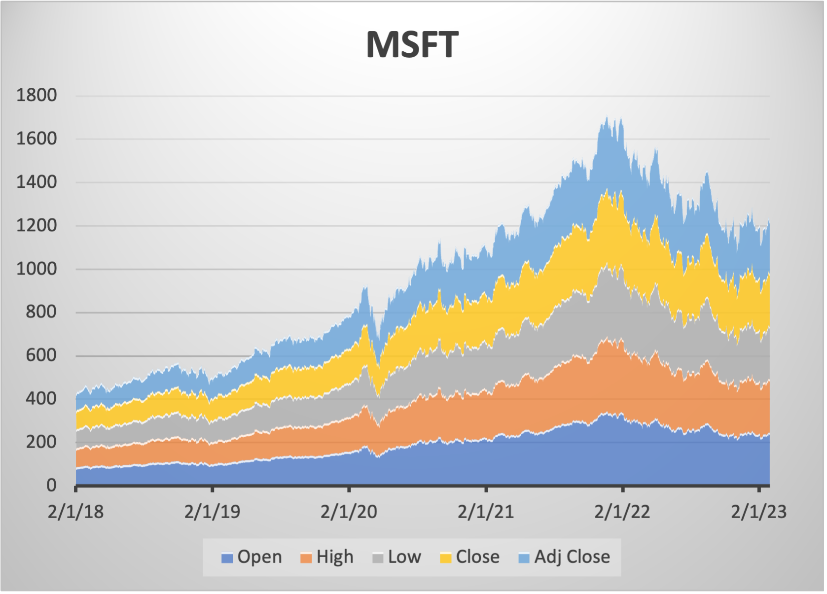
Descriptive Statistics: (Microsoft)

Slide 4
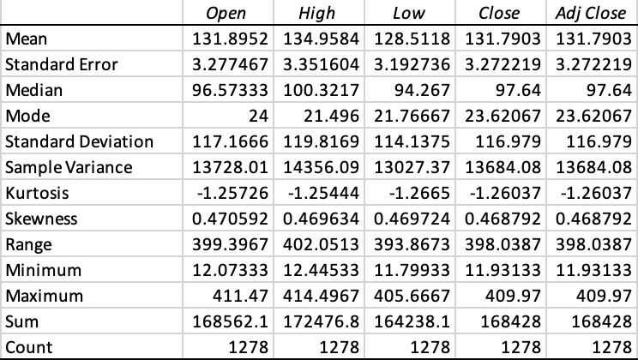
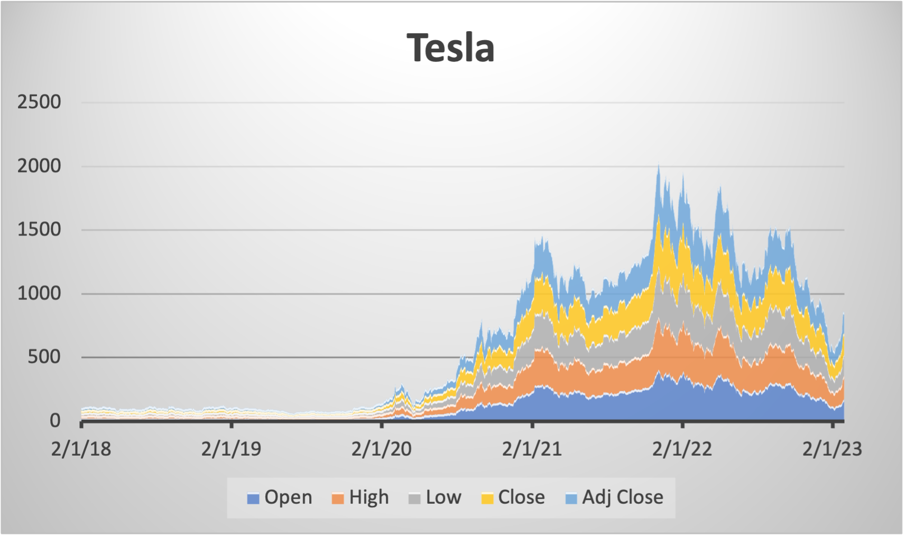
Descriptive Statistics: (Tesla)

Slide 5
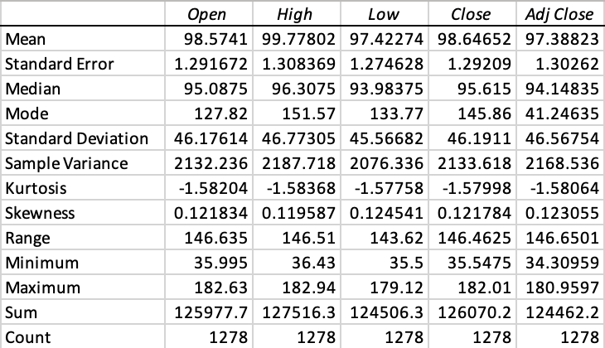
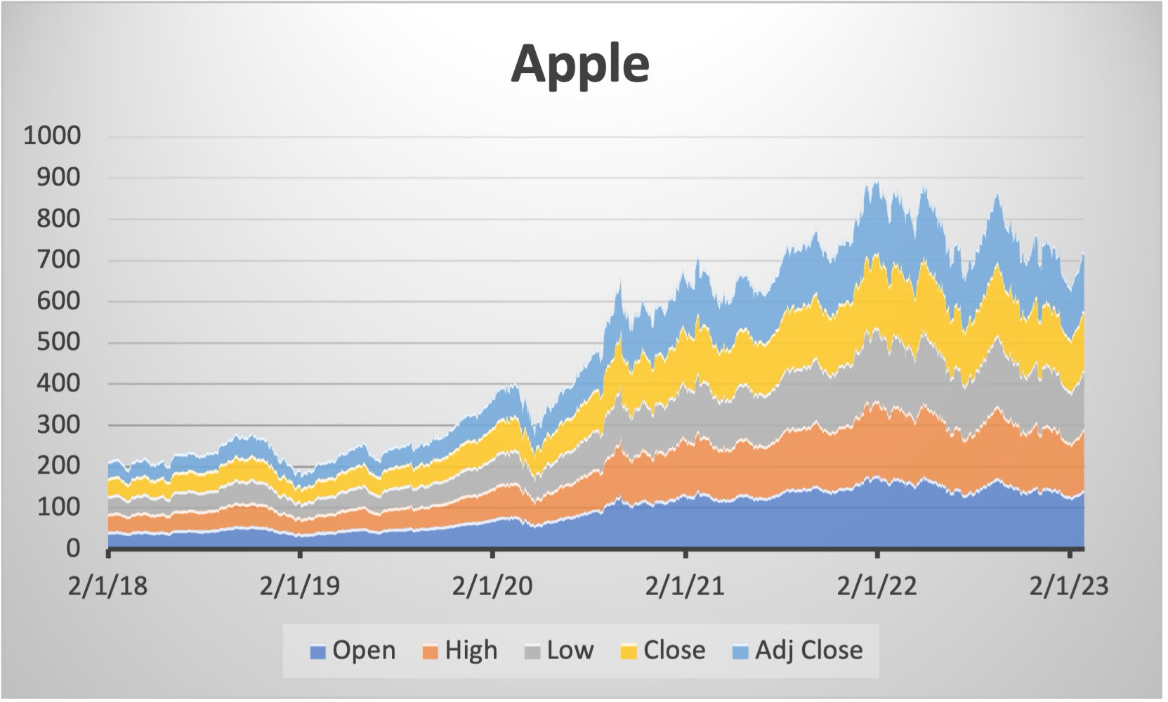
Descriptive Statistics: (Apple)

Slide 6
Regression Analysis

Slide 7
Regression Statistics:
Regression Statistics | Microsoft | Tesla | Apple
Multiple R | 0.776762089 | 0.480470574 | 0.740343208
R Square | 0.603359343 | 0.230851972 | 0.548108066
Adjusted R Square | 0.603048252 | 0.230248719 | 0.547753641
Standard Error | 0.011351118 | 0.038267462 | 0.013919502
P-value | 0.035358715 | 0.043972346 | 0.032330775

Slide 8



Beta Value – Risk Analysis
Microsoft
Tesla
Apple
1.21389489987502
1.817793485765
1.32920677220648

Slide 9
THANKS!

